Slide 1
MANGO likes you

Slide 2

MANGO likes you, Our loyalty club where customers can enjoy exclusive benefits, including:
Earn Likes (points) for every purchase at MANGO, on your birthday, for recycling items, collecting online orders, and more.
Use your Likes to get a unique discount on the items you love the most.
Redeem your Likes for experiences such as music streaming platforms, Premium services, HBO, movie tickets, donations to NGOs, and more.. Experiences: being deprecated since April 2025 in some countries Donations to NGO’s: deprecated in all countries since April 2025
Check your available Likes on the website or app and receive your purchase receipts directly via email.
© MANGO. Strictly confidential, for internal use only.

Slide 3
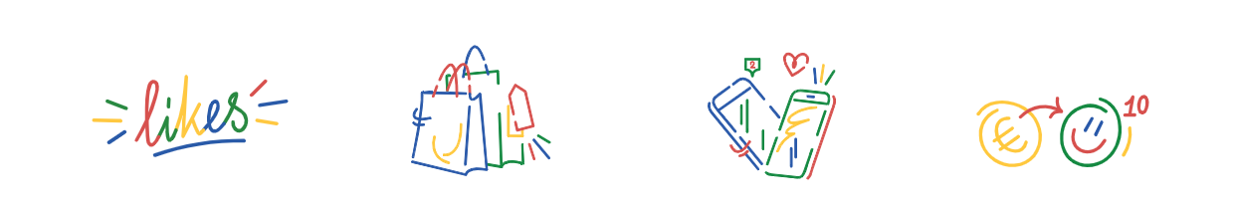
MANGO likes you, our loyalty club:
It's much easier to collect our customers' email addresses and phone numbers because they have a reason to provide them: to receive discounts.
Customer data is automatically saved in our system, and they receive a digital receipt for all their purchases.
We understand our customers better and can send them personalized communications based on their interests and shopping preferences.
We build customer loyalty and encourage them to shop more frequently and make more purchases.
© MANGO. Strictly confidential, for internal use only.

Slide 4
How to register?
In Stores: Provide your email and phone number at Mango stores (excluding Outlet stores, airport stores, and stores without Mango's checkout system).
Online: Register on MANGO.COM or through the APP.
Available Countries: The Club is available in select countries, which are:
Spain since 9/04/2019
France since 29/05/2019 (not active at the moment in DOM-TOM: Martinique, Guyana, Guadalupe, Reunion, etc.).
The Netherlands since 20/05/2020
Belgium since 10/06/2020
Luxembourg since 10/06/2020
Germany since 22/07/2020
Portugal since 9/09/2020
United Kingdom since 28/10/2020
Austria since 24/02/2021
Italy since 10/03/2021
Andorra since 24/03/2021
Türkiye since 02/06/2021
Switzerland since 15/09/2021
Ireland since 15/09/2021
Poland since 21/04/2022
Saudi Arabia since 7/11/2022
United States of America since 8/04/2024
© MANGO. Strictly confidential, for internal use only.

Slide 5
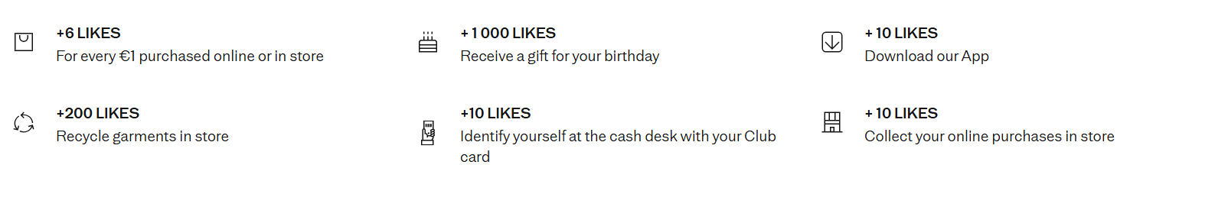
Earn LIKES – (Example: Spain)
Birthday Likes expire 30 days after being received, while other Likes are valid for 1 year.
If Likes are used in a purchase later returned, the returned Likes are valid for 1 year from the initial accumulation date. If they expire before use, they will not be returned.
© MANGO. Strictly confidential, for internal use only.

Slide 6

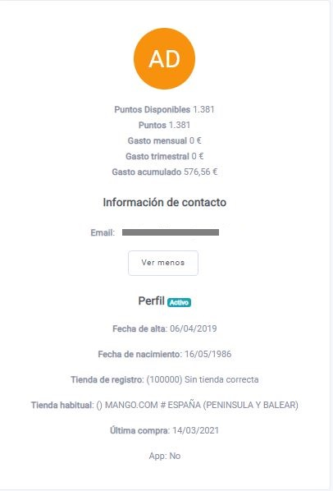
MANAGEMENT of MANGO likes you CUSTOMERS
The management of the members of the Club is carried out through the platform
The platform allows us to view:
Registration date, birthday, available Likes.
Online/physical store purchase and return history (purchase receipts, items purchased, etc.).
Benefits and experiences where the customer has spent/redeemed Likes.
© MANGO. Strictly confidential, for internal use only.

Slide 7
Mango Likes you
KB articles:
Mango Likes You – description
Mango Likes You – General Conditions
Likes expired
Likes Balance
Likes wrongly calculated receipt/order
Likes from a purchase not added
Apply Likes to an existing purchase
Not receiving likes (bday, recyc, checkin).
Likes Transfer Request
Mango Likes you – Likes redeem conditions
Cannot redeem likes
Mango Likes You Partners Incidence
Loyal Guru
Info about our loyalty program, obtaining and using MLY card codes, benefits, earning and redeeming likes, transferring/gifting likes, checking balances, managing returns with likes, and resolving issues such as unadded likes, redemption difficulties, check-in problems, failed donations, and unapplied likes during purchases.
Accessing You Card:
Find your card code in the app under “My Account.”
Present in-store or add to Google Wallet / Apple Pay.
Birthday likes:
1,000 Likes gifted 15 days before your birthday
No code needed – auto-added within 24–48 hrs.
Receiving Likes: Likes may take up to 48 hours to update in your account after making a purchase or action. Likes cannot be obtained or added to your account in any other way.+Not valid for: Outlets , Airport stores / department store corners , Gift card purchases
Redeeming Likes:
In-store: Mention at checkout
.Online: Apply manually at checkout.
Must have min. 1,000 Likes to redeem.
1,000 Likes = €5 discount (€0.005 per Like; may vary by country).
Conditions : Can be combined with promos up to 50% off item price + : Likes cannot be transferred, gifted, sent, or received between different accounts.
Returns / Cancellations: If you return an item or cancel a purchase:
Used Likes are returned (if not expired or reused).
Returned Likes are valid for 1 year from original earning date.
Tools?
KB / Mango Website
Loyal Guru
What about Outlet?
Mango Likes you is only available for Mango.com and Mango Stores.

Slide 8
Unnecessary escalation reason | Description | Solution | Notes
Customer with several accounts | The customer is contacting because they have not received the Likes in their account from a communication they received via SMS (a €5 discount - churn, ad hoc campaign, etc.). | It is likely that the customer has multiple email accounts, and the Likes are in an account they don't usually use. It is recommended to keep only one account active to avoid such "incidents." We remind you that the best way to locate duplicate accounts is by using the phone number. | These cases should not be escalated to Loyalty
Countries NO MLY | Customer not earning Likes for purchases | If the customer resides in a non-MLY country (Dom-Toms, Russia, Denmark, Czech Republic, Sweden, etc.), it is normal that they do not accumulate Likes because they are not part of the Club. | These cases should not be escalated to Loyalty
Partners | The customer accidentally redeemed Likes and wants to cancel the subscription or movie ticket. | It is not reversible - a code cannot be canceled once requested. The customer has until the date indicated in the email to redeem the coupon. | These cases should not be escalated to Loyalty
Partners | Resend a code if the customer has not received it. | The agent has autonomy to perform this action. Check if there are codes in SF to forward.Do not escalate it to Loyalty | "ONLY IN THESE CASES!! If the codes in Salesforce are not available, the Likes can be returned to the customer. Do not pass to Loyalty.
Partners | Credit back the Likes to the customer's account if the code they received is expired | The agent has autonomy to perform this action. Do not escalate it to Loyalty | ¡¡ONLY IN THESE CASES!! If code received is expired, you can return likes to customer. Do not pass to Loyalty.
Most MLY cases related to PARTNERS can be resolved by an agent.
Incidence, incorrect reporting | The agent sends the incident report incompletely. | Provide the customer's contact ID, or email and phone number if we don't have the ID, date, store, etc. The more data, the better. Without all these details, the case will be reported as poorly managed. | "ATTENTION! Before sending the case to Loyalty, verify with all our platforms (SF, LG, etc.) if we have all the necessary information to resolve the case without reporting it to Loyalty.
MLY Discount is not applied | The agent forwards the case because the customer does not see the option to redeem Likes at the time of check-out. Verify if there is a problem with the account. | Customer information and screenshots of the check-out moment with all the details are required: item price, reference, purchase date, etc. Without all these details, the case will be reported as poorly managed.
Incidence, incorrect reporting | The agent claims there is an error in the calculation of Likes from the customer's purchases but does not specify what the error is or which purchase. | Be specific and indicate the purchase where the error in the conversion of Likes occurred. As with the previous case, the more information, the better. If incomplete, the case will be reported as poorly managed.
Likes Transfer | Transfer Likes from one account to another | The agent has autonomy to perform this action. Do not escalate it to Loyalty | These cases should not be escalated to Loyalty
Account Takeover | The customer has purchases in their profile that are not theirs. | Redirect customer to report it to personaldata@mango.com with all details, or if you have them, escalate it to personal data. | To Personal Data, not LOYALTY
Inconsistency of established flow | Identification in store with an account that is not theirs | If the account owner is not present in the store, their account cannot be used due to fraud concerns. If the customer making the purchase does not have an MLY account, they must create their own account and then contact ATC to transfer the Likes to the desired account. (THIS INFORMATION IS INDICATED IN THE CLUB CONDITIONS) Note that stores are very clear about this procedure.
LOYAL GURU Platform
Incidence | Description | Solution | Notes
Bad Practice using LG | The agent uses options on the platform that are not intended for use by our company MANGO, e.g., deleting account, redeeming reward. Additionally, the agent uses the comment field incorrectly by adding notes, which then appear published on the customer's profile on the WEB. | Adhere to the KB instructions; under no circumstances will accounts be deleted on this platform, and no comments will be added that do not contain the information indicated in the KB. | Remember that this platform is not only used by MANGO, so options that are not ours may appear. When in doubt... consult."

Slide 9
Thank you!

